Slide 1
OSPA Outreach & Collaboration Our Role, Services, Strategies, & Initiatives To Facilitate Research Funding
Office Of Sponsored Projects Administration (OSPA) - SIUC
SIUC College Of Health & Human Sciences
Location & Time
Date: Tuesday, March 9th 2021
Time: 3:00 pm – 4:00 pm (Central Time)

Slide 2
Agenda Topics
Introductions
OSPA Strategic Vision @ SIUC
Initiatives & Funding Opportunities
Managing Research With Best Technology
System Information & Automation
Partnerships & Collaborations
Operational & Business Process Improvements
Roles & Responsibilities (OSPA Teams – Departments – Investigators)
Conflict of Interest & Export Control
Realtime Reports & Dashboards
Adverse Impacts – Grants Management
Questions & Answers

Slide 3
OSPA Strategic Vision @ SIUC
Process
Service
Technology*
People*
Streamline
Grants Business Processes
Automation
&
System Processing
Effective Communication & Training
Realtime Reports & Dashboards
Simplify Audit & Compliance Processes
Timely Submission & Deliverables
Accounting & Award Life Cycle

Slide 4
OSPA Strategic Vision @ SIUC
Apply Best In Class Strategies To Attain Sustainable Process, To Promote And Support Increased Research Funding
Effective Communication and Collaboration
Increase Funding opportunities chances for Principal Investigators
Streamline Award Setups for Promptness and Budget Review.
Automate System and Transaction Processing for Effectiveness and Timeliness.
Ensure Consistency and Realtime Reporting for OSPA, Investigators, and All Stakeholders.
Manage Proposal Submission, Award Lifecycle Tracking, Research Cost, Accounting, and Award Closout
Timely Submission of External Deliverables.
Reporting (Reports & Dashboards).
Audit Process Simplification and Compliance Checks.

Slide 5
Initiatives & Funding Opportunities
SIUC Current State – Grants Forward Database
GrantForward – https://www.grantforward.com/signup
Extensive database with over $9,000 sponsors
Personalized funding recommendation to simplify the search process
Adaptive search filters
Sign up for an account on Grant Forward:
Research Matters Listserv – http://listserv.siu.edu/scripts/wa.exe?SUBED1=RESEARCH-MATTERS-L&A=1
Stay up to date on the latest research news
Distribution of internal and external funding opportunities
Research Development & Grant Writing News publication
How many of you frequently use GrantForward Database?

Slide 6
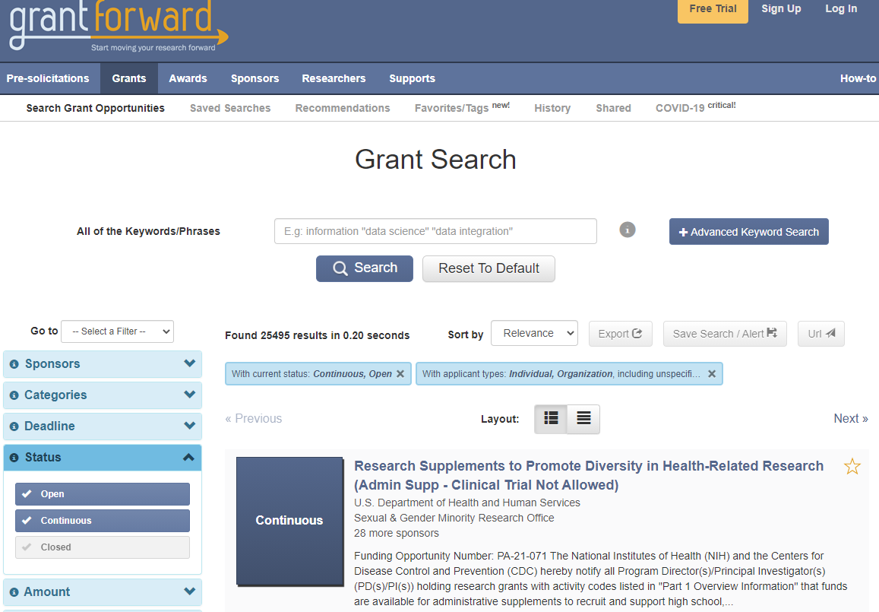
Initiatives & Funding Opportunities-1
SIUC Current State – Grants Forward Database

Slide 7
Initiatives & Funding Opportunities-1
ExLibris Pivot-RP Database
Partnering with ExLibris Pivot-RP (Formerly the Community of Science (COS))
Embedding Pivot-RP Search Engine on OSPA & Other Webpages – Research Funding Insights. Support Diversity of Interest. One-Stop Shop for Finding Funding. Improving Success with Limited Submission. Community Power & Insight.
Pivot-RP Video – Leveraging Best Practice Business Systems To Improve Funding Opportunities.
ProQuest – World’s Largest Collection of Curated Academic Content.
Increased Funding Comes with Additional Needs Expected increase in submissions and funding cannot be managed effectively without a good tool/application/system at SIU-OSPA.

Slide 8
Initiatives & Funding Opportunities-1
Pivot Is Considered The “Gold Standard” For Funding Opportunity
Most comprehensive search engine for grants funding opportunities available.
Enables researchers to identify potential funding opportunities –
Ability to receive periodic grants funding alerts based on your research profile
Identify potential collaborators with other universities around the world using Pivot Profiles
Searchable database of external funding opportunities that comprise approximately $50 billion of available funding.
Investigators can set up customized searches and receive e-mail alerts about new opportunities that match their research interests.
Pivot also offers excellent university/institution liaison support, training, and user guides.
ProQuest - Pivot-RP is the World’s Largest Collection of Curated Academic Content.
Billions of $
in funding
Thousands of individual opportunities
Wide variety of sponsors & funding types
Global reach
Millions of profiles & previously awarded grants
Editorially created researcher profiles

Slide 9
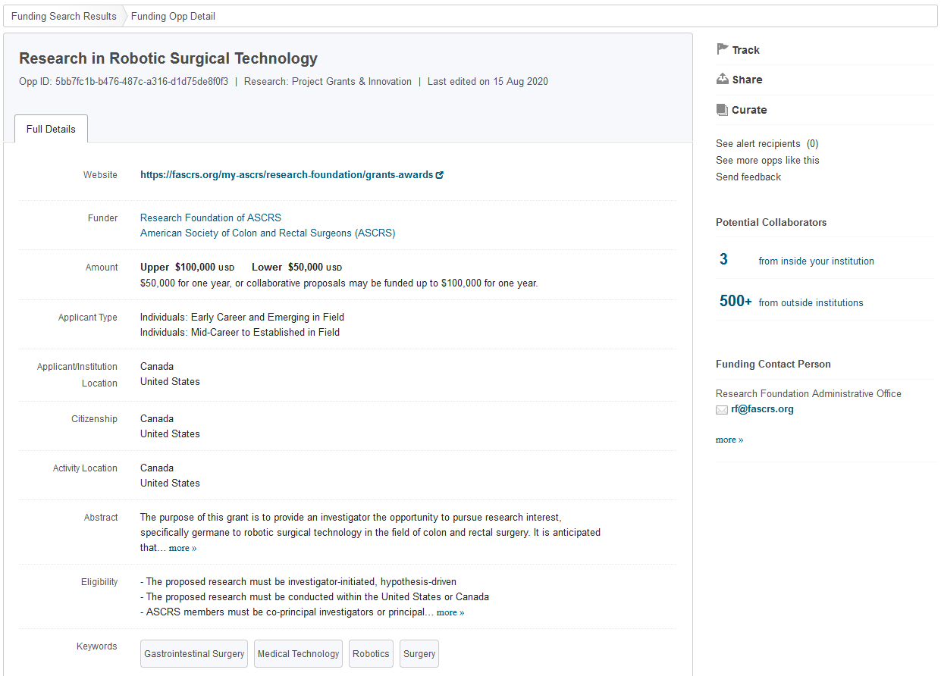
Initiatives & Funding Opportunities-1
Detailed Funding Opportunity
Automatically Matched to Researcher Profiles!
All the details needed to determine eligibility, deadlines, key contacts and more!

Slide 10
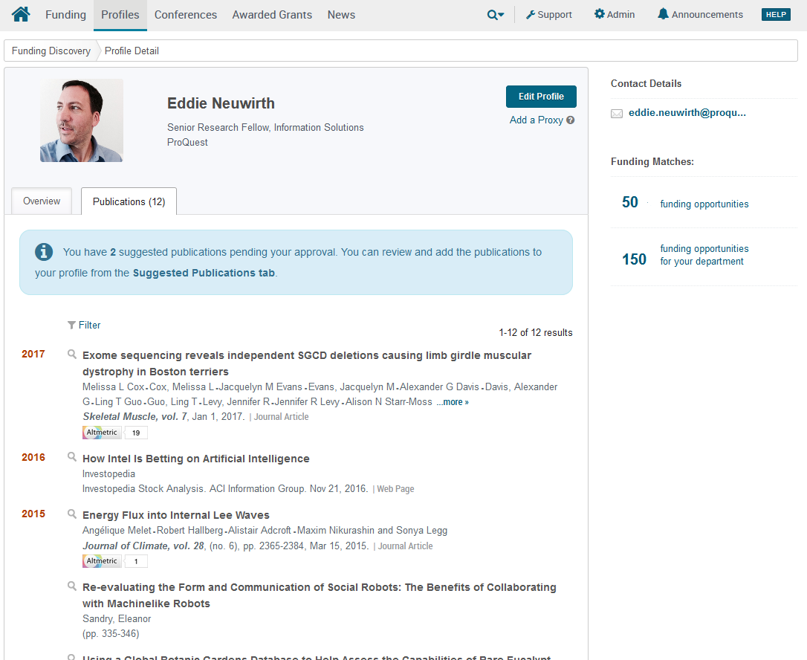
Initiatives & Funding Opportunities-1
Detailed Biographic Profiles and Publication List
Automatically matched to Funding Opportunities at the individual and department level!

Slide 11
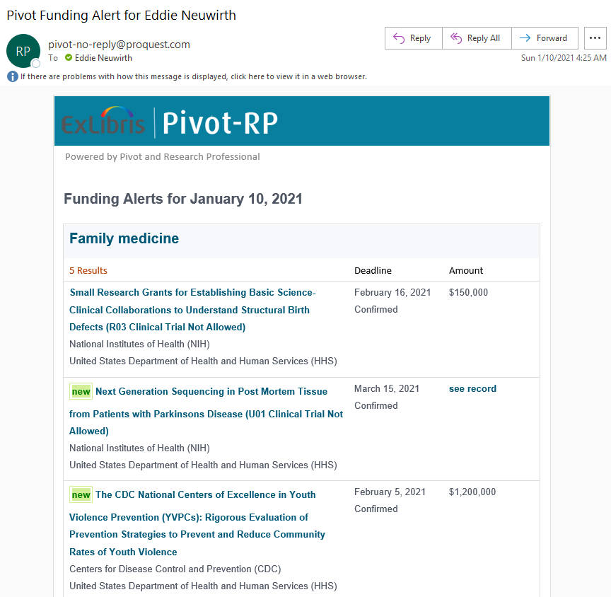
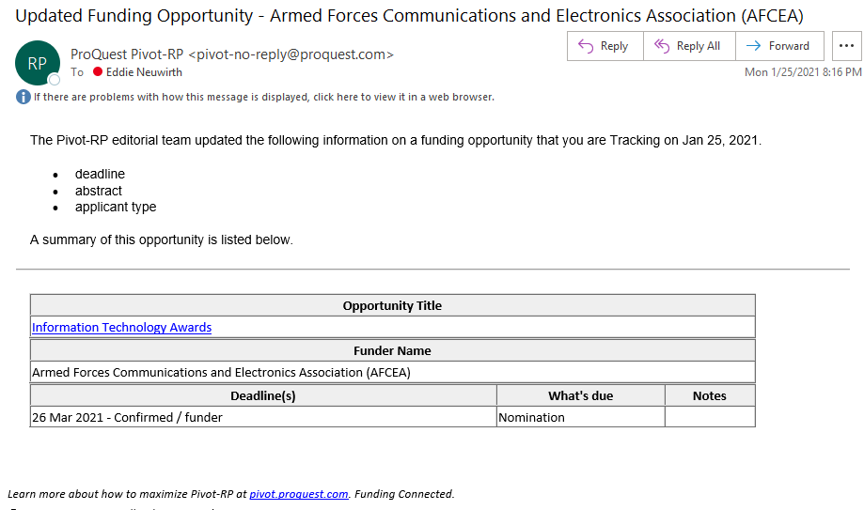
Initiatives & Funding Opportunities-1
Example of Automated Email Alert
Recommended Funding, Important Updates and Alerts automatically delivered directly to users’ inboxes

Slide 12
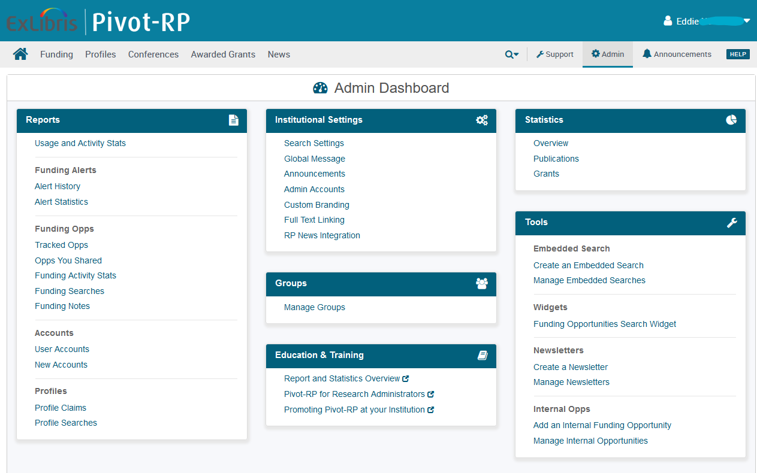
Initiatives & Funding Opportunities-1
Extensive Admin Dashboard & Reports
Reporting options for:
Usage and Activity Stats
Funding Activity Stats
Funding Searches
Profile Claims
Profile Searches
Configuration Options for Admins:
Generate announcements and send global messages
Curate and send newsletters
Create Groups
Add internal funding opportunities
Funding Alert History
Provides visibility into how the service is being used and into which funding opportunities are being recommended to which researchers!

Slide 13
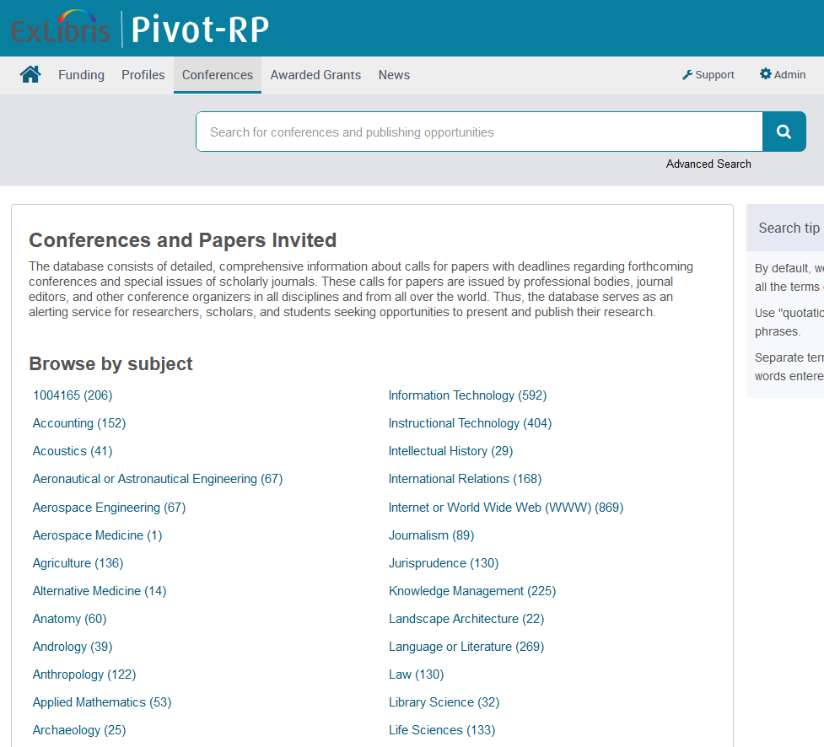
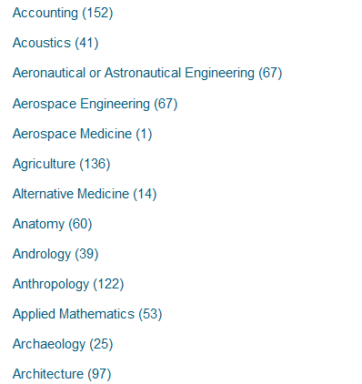
Initiatives & Funding Opportunities-1
Conferences & Papers Database
Integrated search of editorially curated collection of calls for papers issued by professional bodies, journal editors and other conference organizers in all academic disciplines.
Opportunities for researchers to get their work noticed
Advanced Search
Powerful filters and relevance and date sorting
View Organizers, Eligibility, Location, Important Dates, Keywords and Topics, and Links to Websites

Slide 14
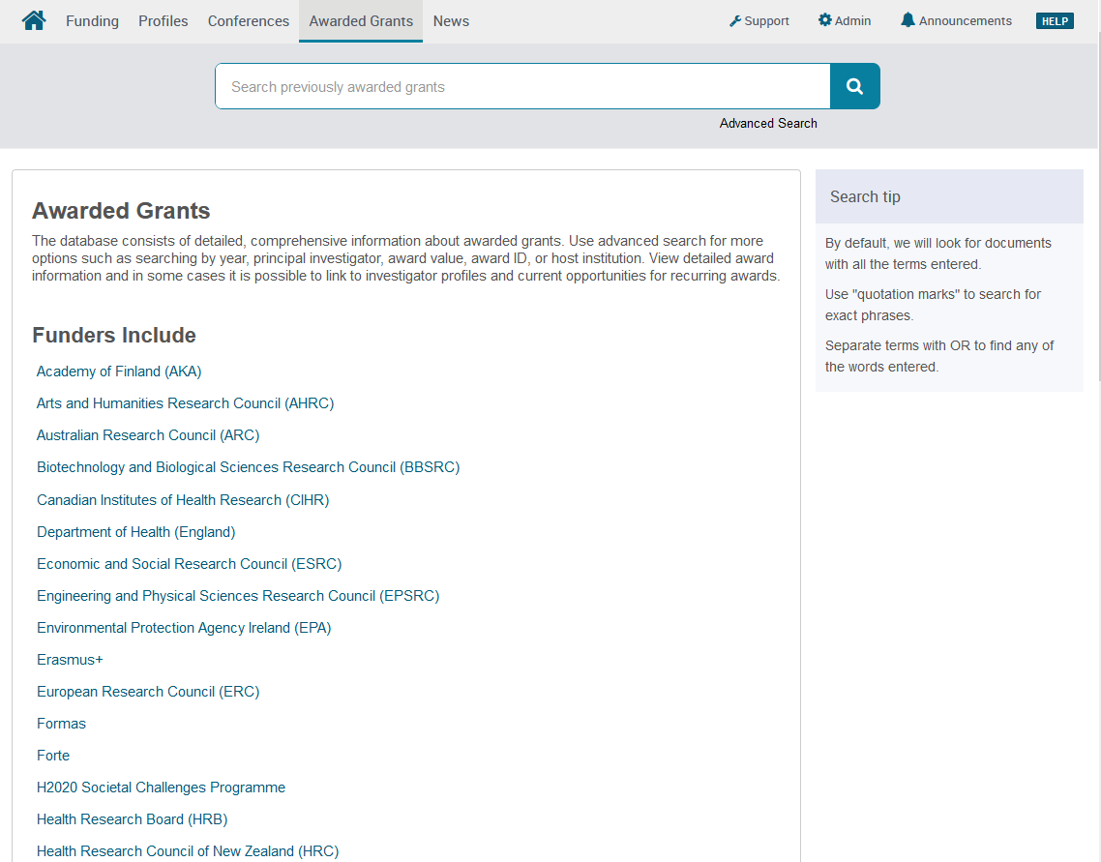
Initiatives & Funding Opportunities-1
Funding Insight: Searchable Awarded Grants
Previously awarded grants provide valuable insights into previous winners!
Make informed decisions about what opportunities to apply for based on a better understanding of what funders have funded in previous rounds

Slide 15
Initiatives & Funding Opportunities-1
Widely Distribution Of Sponsors And Funding Types
25.3% | Professional Society or Association
24.8% | Private Foundation/Other, Nonprofit
14.1% | US Federal Government
13.7% | National Government, non-US
8.7% | Academic Institution
6.1% | Public Sector, National
4.1% | State, Province or Local Government
2.3% | Commercial/Private Sector
0.9% | Multinational Organization

Slide 16
Initiatives & Funding Opportunities-1
Wide Variety Of Opportunity Types
More than 23,000 active opportunities on average
More than 13,000 sponsors tracked
Global database – 50% of funding is from non-US sponsors

Slide 17
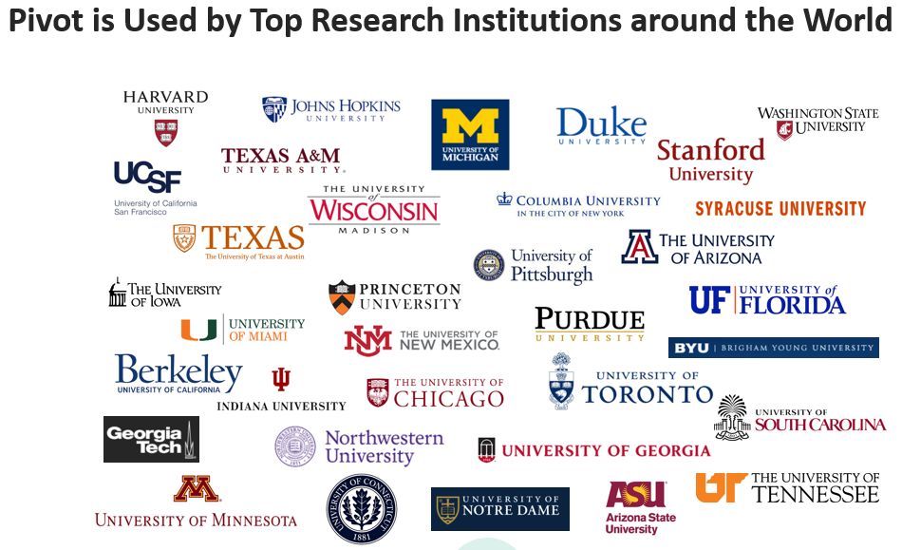
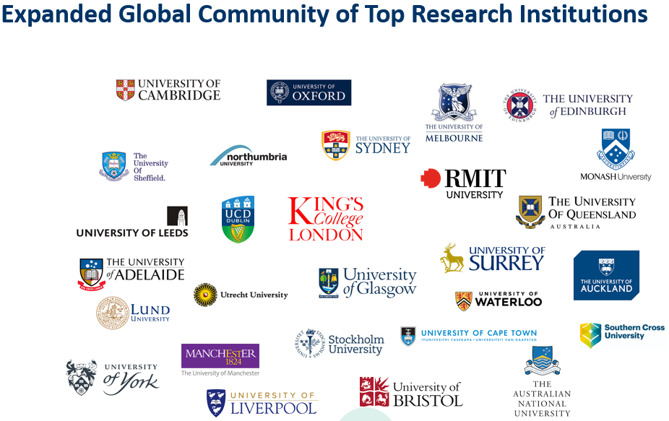
Initiatives & Funding Opportunities-1
Pivot Is Considered The “Gold Standard” For Funding Opportunity

Slide 18
Initiatives & Funding Opportunities-1
Partnering Institutions Currently Leveraging ExLibris Pivot-RP Search Engine
University of Michigan - https://guides.lib.umich.edu/c.php?g=283405&p=1888659
University of Chicago - https://ura.uchicago.edu/page/pivot
University of Nevada, Las Vegas - https://www.unlv.edu/research/osp/pivot
University of California, San Francisco - https://osr.ucsf.edu/content/find-funding-opportunities#extramural-funding
Massachusetts Institute of Technology (MIT) - https://ras.mit.edu/finding-funding/find-funding
University of Pittsburgh - https://www.osp.pitt.edu/find-funding
Harvard University - https://ecor.mgh.harvard.edu/awards-and-grants/cos-pivot----external-funding-search-engine
Indiana University - https://news.iu.edu/stories/2021/02/iu/inside/10-pivot-funding-search-tool-helps-faculty.html
University of Connecticut - https://guides.lib.uconn.edu/c.php?g=606741&p=4899012
University of Arizona - https://rgw.arizona.edu/development/find-funding/external-funding/cos-pivot
The University of Vermont - https://www.uvm.edu/spa/pivot-funding-collaboration-tool-searchable-databases
University of Nevada, Reno - https://www.unr.edu/research-innovation/research-hub/grant-funding-database
University of Wisconsin - https://researchguides.library.wisc.edu/c.php?g=177764&p=1170446
University of Florida - https://research.ufl.edu/finding-funding/cos-pivot-funding-database.html
University of Texas at Austin - https://research.utexas.edu/find-funding/pivot/
Boston University School of Medicine - https://www.bumc.bu.edu/busm/research/find-funding-2/pivot-funding-database/
Texas State - https://www.txstate.edu/research/ord/pivot
The University of Mississippi - https://research.olemiss.edu/proposal-development/cos_temp
University Oregon - https://research.uoregon.edu/plan/find-funding/external-funding-opportunities/pivot-funding-database
University of Iowa - https://dsp.research.uiowa.edu/pivot-funding-database-available-ui-community
Kean University - https://www.kean.edu/offices/research-and-sponsored-programs/external-funding/finding-funding-using-pivot
University of Kansas - https://research.ku.edu/pivot-proquest-database
University of Missouri - https://research.missouri.edu/ospa/pivot_funding.php
Drexel University - https://www.library.drexel.edu/news-and-events/news/libraries-news/2019/February/Pivot_Update/

Slide 19
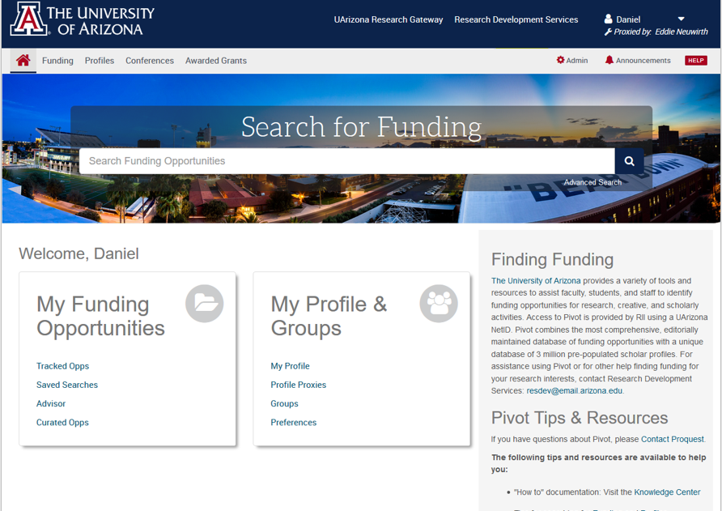
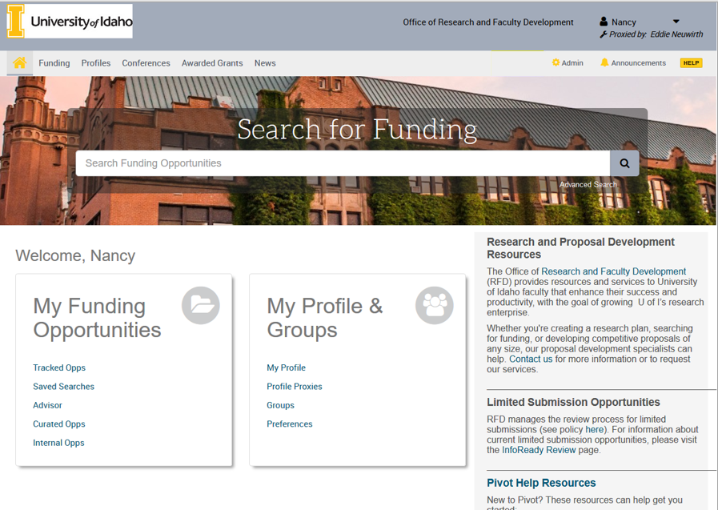
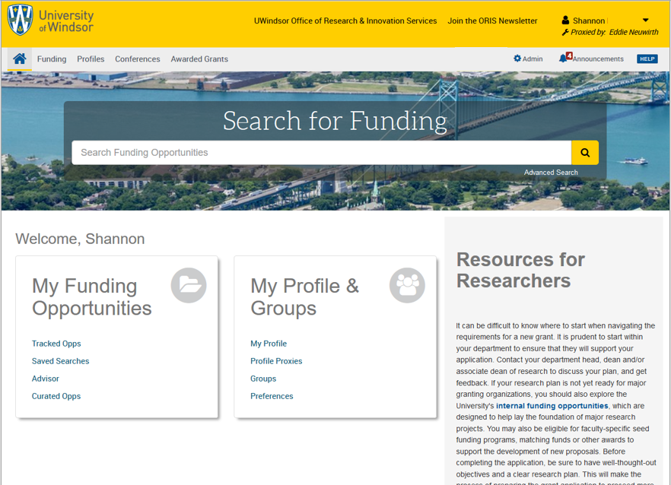
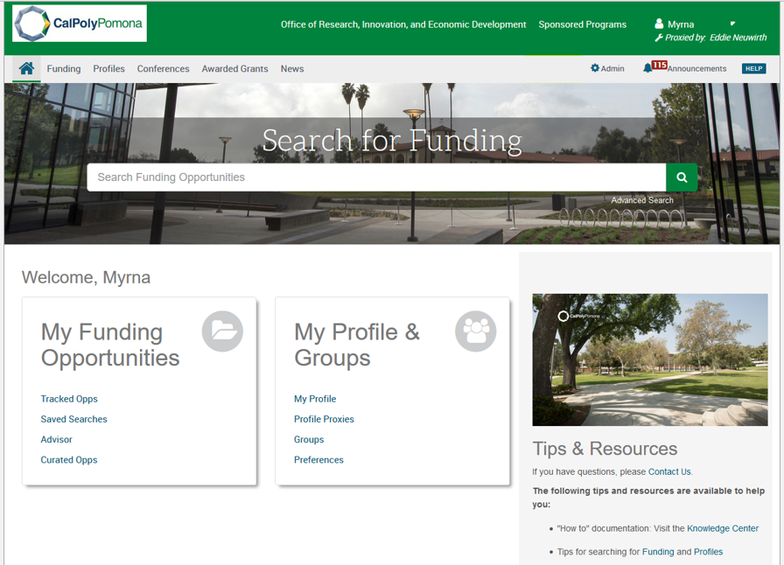
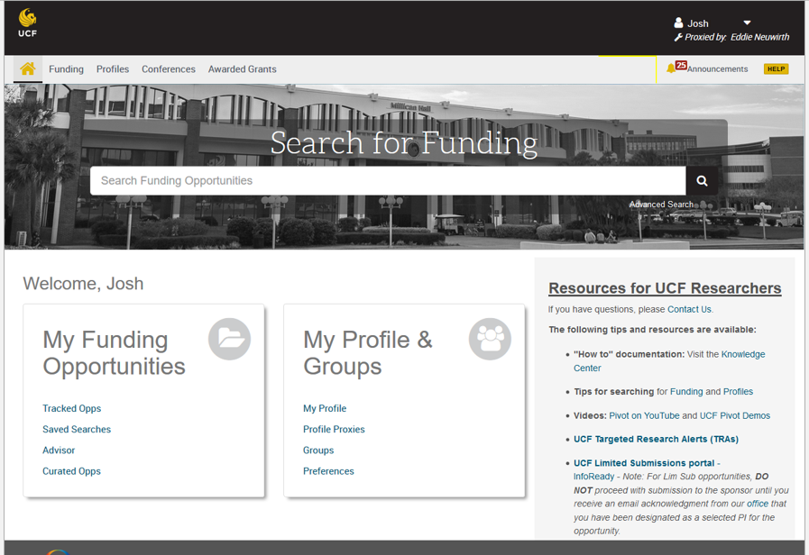
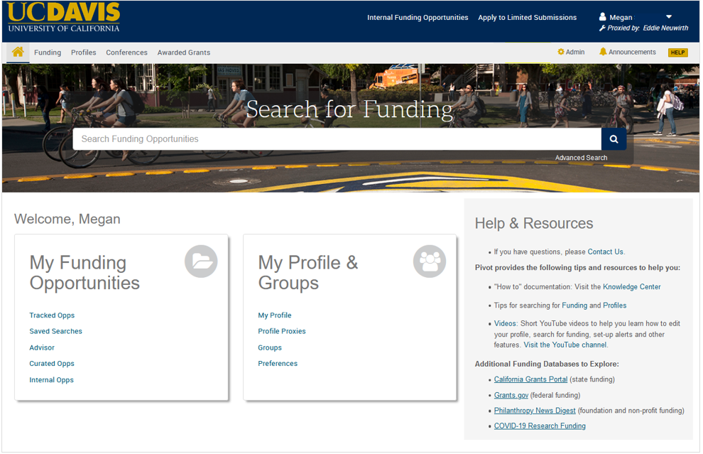
Initiatives & Funding Opportunities-1
Many Institutions Take Advantage of ExLibris Pivot-RP New Feature

Slide 20
Initiatives & Funding Opportunities-2
Partnering Institutions Currently Leveraging Academic Analytics Search Engine
Target Funding Opportunities
Strategic Planning
Faculty Development
Create a Research Center or Institute
Showcase Faculty Scholarship
Foster Team Science
Institutional Advancement
Graduate Placement in Academia
Develop a Publication Strategy
Subject Matter Expertise Identification

Slide 21
Initiatives & Funding Opportunities-2
Partnering Institutions Currently Leveraging Academic Analytics Search Engine
University of Missouri System: https://scholars.umsystem.edu/dashboard
Michigan State University - https://scholars.msu.edu/dashboard
Michigan State University
North Carolina State University
Rice University
University at Buffalo – The State University of New York
University of Illinois at Chicago
University of Miami
University of Missouri – Columbia
University of Missouri – Kansas City
Virginia Tech
University of Texas San Antonio - https://utsa-discovery.beta.academicanalytics.com/dashboard
Massachusetts Institute of Technology (MIT) - http://mit.academicanalytics.com/
Boston University
Clemson University
East Carolina University
Georgia State University
Indiana University Bloomington
Wayne State University
Washington University in St. Louis
University of Kansas
Northern Arizona University

Slide 22
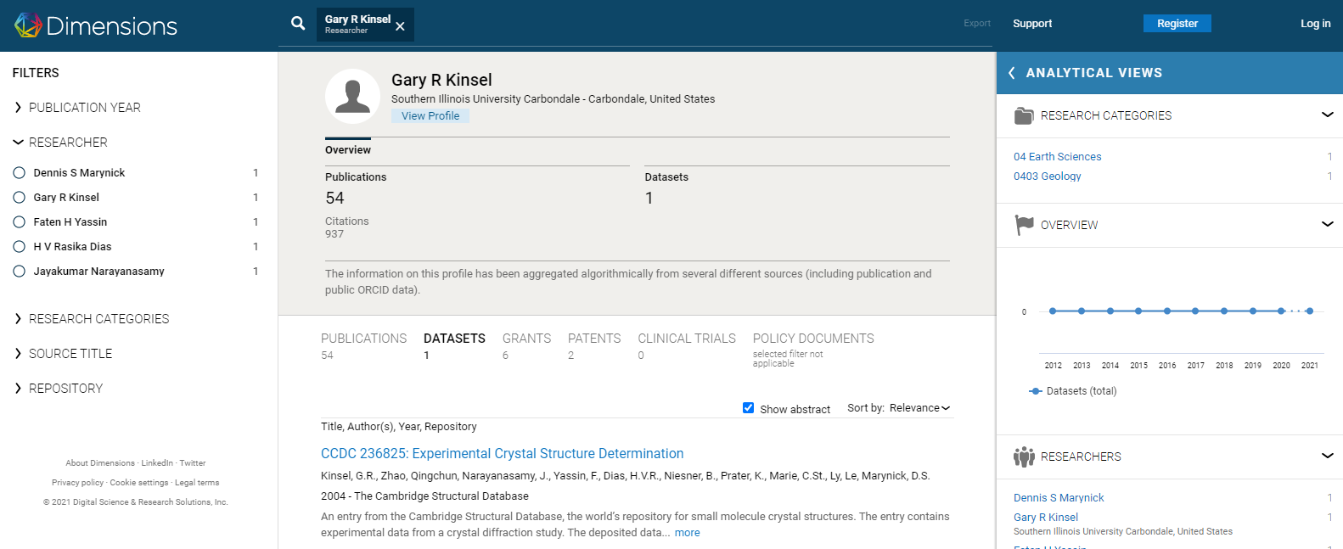
Operations & Business Process Improvements (Pre-Award)
OSPA Leverages Dimensions Research Database To Support Investigators Research
https://app.dimensions.ai/discover/publication

Slide 23
Operations & Business Process Improvements (Pre-Award)
Potential Increased Funding Require Adherence To OSPA Business Process Guidelines For Success
Onboarding of New Principal Investigators
Training – OSPA Training Sessions with Certified Research Administrators.
Funding opportunity – Review and Perform Eligibility Determination.
Budget – Assist Investigators with Budget Development.
Internal Review – OSPA Assists with Internal Routing Forms Process & Review.
External Review – OSPA Assists with Agency Submission Portal Reviews

Slide 24
Operations & Business Process Improvements (Pre-Award)
Potential Increased Funding Require Adherence To OSPA Business Process Guidelines For Success
On-Time Proposal Submission
Proposal Notification.
10 Days Advance Submittal To OSPA.
To Facilitate OSPA’s Comprehensive Review.
Receipt of All Required Documentations For Proposal Submissions.
Ability To Follow Up and Perform Additional Activities To Track Submitted Proposal Statuses.
Timely Proposal Negotiations
Waiver or Reduction of Indirect Cost Rate.
Limited Submission Opportunities.
Cost Share Commitments & Subrecipients Requirements.
Compliance.

Slide 25
Operations & Business Process Improvements (Post-Award)
Potential Increased Funding Require Updated OSPA Systems & Technology For Success
Improve Financial Management of Sponsored Awards
Reduce Awards Setup Time To Facilitate Spending.
Budget & Cost Control Management – (Including Subcontracts and Cost Share).
Reports & Deliverable Submission.
Award Closeout and Timely Reconciliation.
Billing, Invoicing, and Receivables
Automate Business Processes like Billing, Cash Draw etc…
Continuously Improve Service and Communication with Research Department for Accurate Invoicing.
Reporting and Dashboards
Executive and Management – Award Status & Financial Health.
Department and Investigators – Summary and Detail Award Financial Information.
Sponsoring Agencies Deliverables – Timely Submissions of Invoices and Cash Draws.

Slide 26
Managing Research With Best Technology
Can OSPA’s Current State Effectively & Efficiently Support Increased Funding?
Current State of System Operations
Future State of System Operations
Our Current System Require An Upgrade

Slide 27
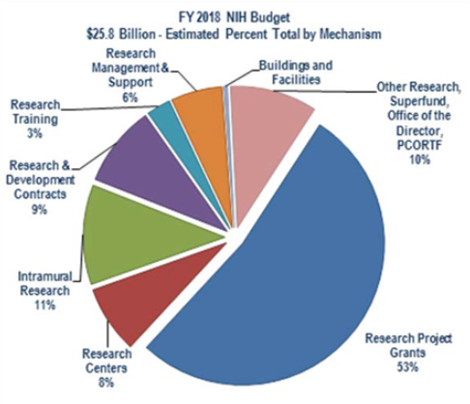
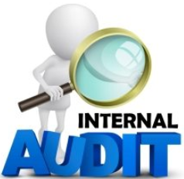
Managing Research With Best Technology
OSPA Needs An Upgrade of The Grants Management Systems To Support Increased Research Funding For Productivity
Analytics – Dashboards – Reports – Scalable For Growth – Audits

Slide 28
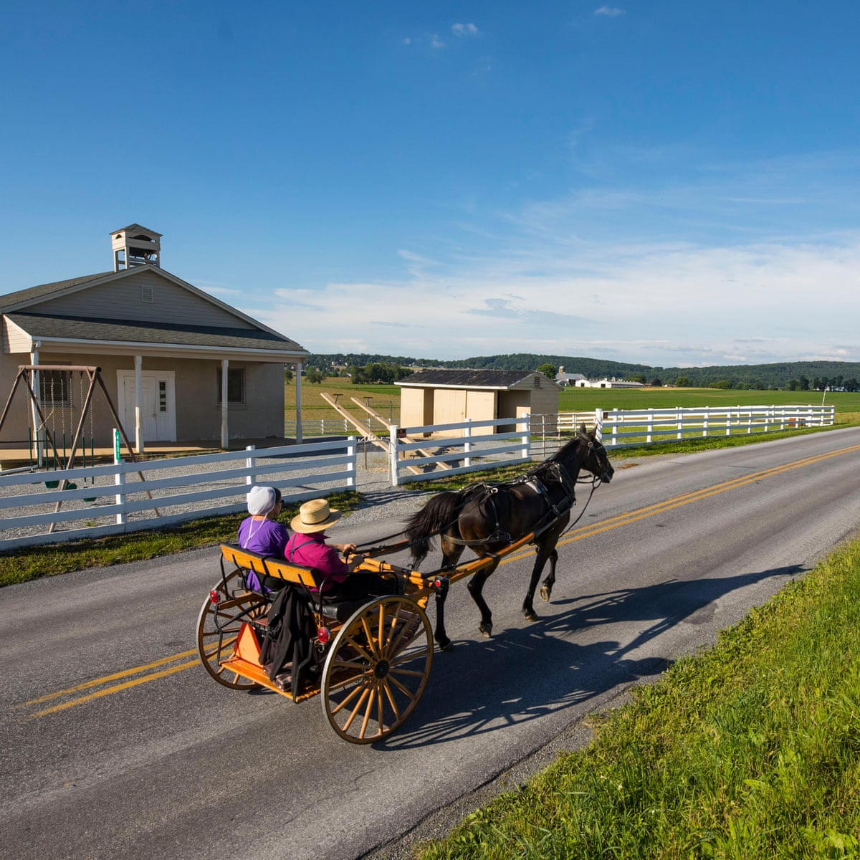
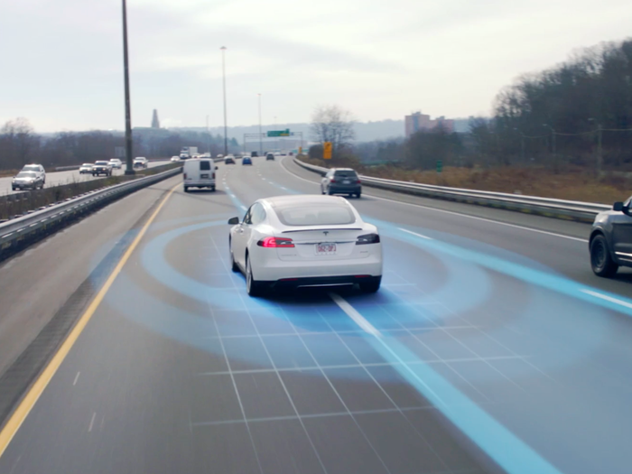
System Information & Automation
Current State of System Operations
Future State of System Operations
Which
Tool Do You Use?
How Do You
Perform?
What is Your
Result?
Do You Deliver?
Do You Plan To Grow?

Slide 29
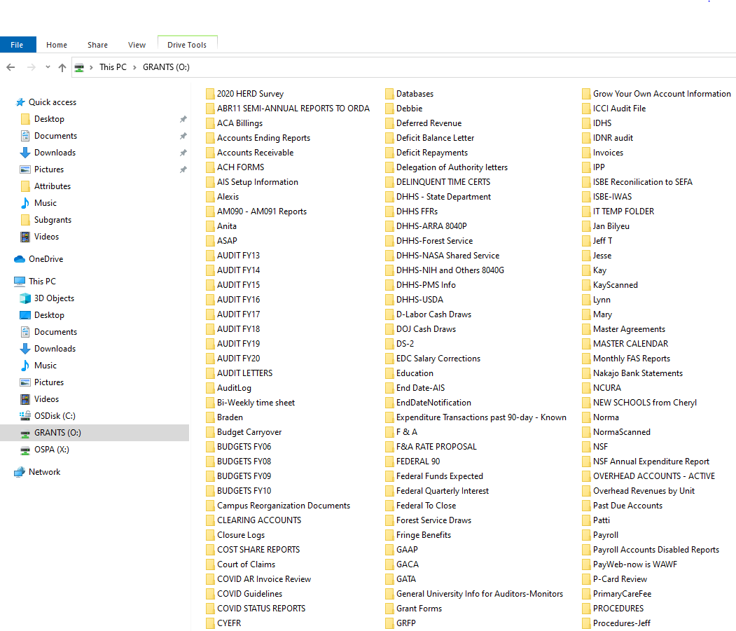
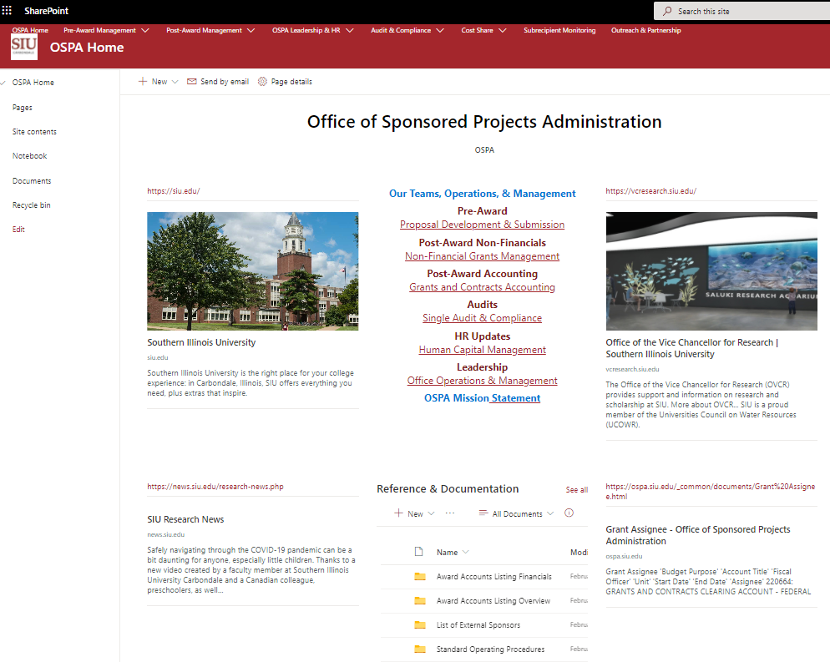
System Information & Automation
Current State of Document Library (Remote Share Drives)
Future State of Document Library (New OSPA SharePoint)
Which
Tool Do You Use?
How Do You
Perform?
What is Your
Result?
Do You Deliver?
Do You Plan To Grow?

Slide 30
Partnership, Collaboration, & Support
Institutional Leadership Support
Leadership’s Support and Participative Decision Making.
Support and Collaboration amongst all Stakeholders (Depts., Units, OSPA, Etc…).
Understanding How ERP Grants System Impacts Business Processes
Impact of changes in Research business processes and organization.
Demands and Impact on Employees.
Training of Employees.
Risk Identification
Risk Tolerance and Conflicts.
Risk to Data For Using Unsupported Access Databases (Current State).
Limiting Potential Growth.
SIUC LEADERSHIP
SUPPORT

Slide 31
Roles & Responsibilities (OSPA Teams – Departments – Investigators)
Identifying Roles and Responsibilities (RR) Amongst All Stakeholder at SIU
Establishing RR Matrix To Define OSPA & Research Department Operational Duties For Success

Slide 32
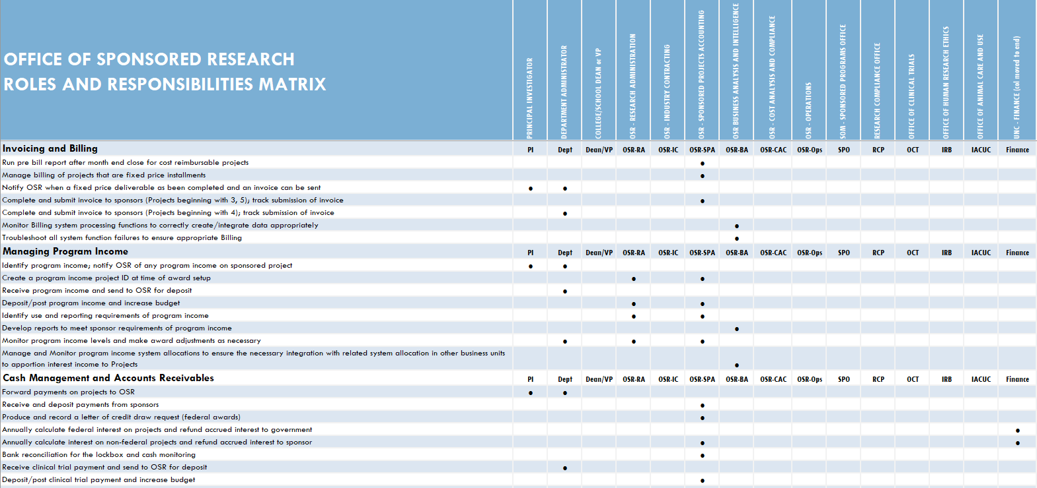
Roles & Responsibilities (OSPA Teams – Departments – Investigators)

Slide 33
Conflict of Interest & Export Controls
Ensuring Researchers Are Complying With Research Compliance Requirements
Example: Conflict of Interest - Financial Interest on Grants Disclosure Statement. https://policies.siu.edu/personnel-policies/chapter4/ch4-all/confint.php
Ensuring Researchers Are Complying With Export Controls Requirements
SIU System Export Controls Web-page. https://siusystem.edu/academic-affairs/export-controls/index.shtml
OSPA is in collaboration with The Office of Export Control, Conflict Of Interest, and Other Stakeholders To Ensure Investigators are in compliance with relevant policies. Such as:
- University Ethics Office - Statement of Economic Interest Form/Supplemental Form.
- SIUC - Annual Disclosure of Proposed Non-University Activities and Financial Interest.
- SIUC - Financial Interest on Grants Disclosure Statement.
- SIU-MEDICINE - Annual Conflict of Interest Disclosure Form.
- SIUE - Kuali Research Conflict of Interest (COI) Module.

Slide 34
Realtime Reports & Dashboards

Slide 35
Adverse Impacts – Grants Management
Financial Statements
Sponsoring Agencies
Inability To Attract Additional Research Funding
Unable To Fulfill Sponsors requirements for Compliance
Not Attracting Talented Researchers / Scholars / Innovators
Not Meeting Responsibilities and Commitments to Sponsors
Researchers Innovators
Sponsored Grants
Compliance
Scholars
Research Funding

Slide 36
Questions & Answers
Let’s Discuss Additional Questions

Slide 37
We Appreciate Your Time & The Collaboration

